Slide 1

Software
Reliability

Slide 2
Software Reliability
Basic Concepts
There are three phases in the life of any hardware component i.e., burn-in, useful life & wear-out.
In burn-in phase, failure rate is quite high initially, and it starts decreasing gradually as the time progresses.
During useful life period, failure rate is approximately constant.
Failure rate increase in wear-out phase due to wearing out/aging of components. The best period is useful life period. The shape of this curve is like a “bath tub” and that is why it is known as bath tub curve. The “bath tub curve” is given in Fig.7.1.

Slide 3
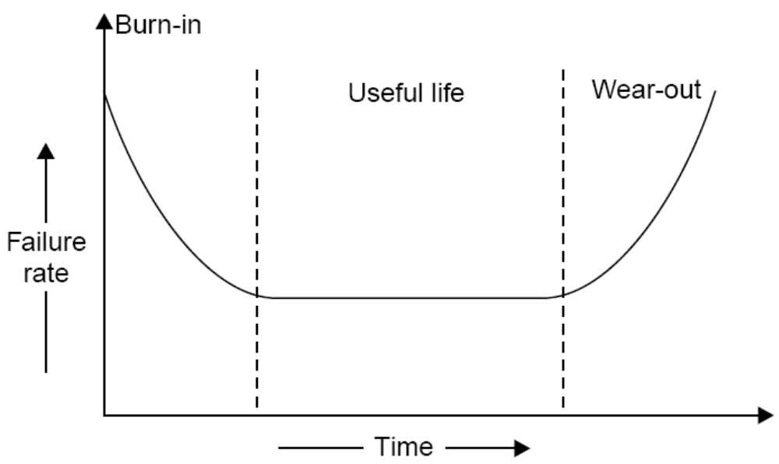
Software Reliability
Fig. 7.1: Bath tub curve of hardware reliability.

Slide 4
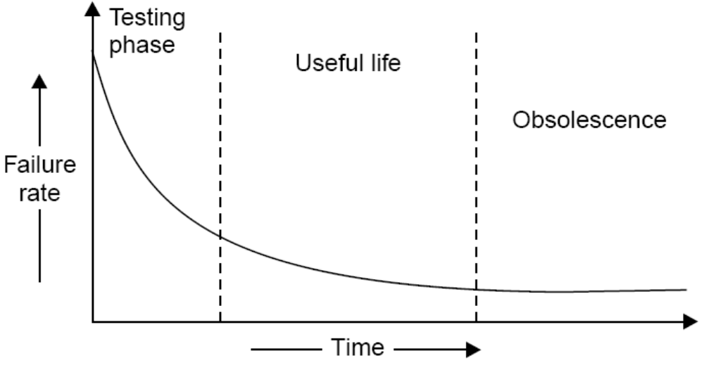
Software Reliability
We do not have wear out phase in software. The expected curve for software is given in fig. 7.2.
Fig. 7.2: Software reliability curve (failure rate versus time)

Slide 5
Software Reliability
Software may be retired only if it becomes obsolete. Some of contributing factors are given below:
  change in environment
  change in infrastructure/technology
  major change in requirements
  increase in complexity
  extremely difficult to maintain
  deterioration in structure of the code
  slow execution speed
  poor graphical user interfaces

Slide 6
Software Reliability
What is Software Reliability?
“Software reliability means operational reliability. Who cares how many bugs are in the program?
As per IEEE standard: “Software reliability is defined as the ability of a system or component to perform its required functions under stated conditions for a specified period of time”.

Slide 7
Software Reliability
Software reliability is also defined as the probability that a software system fulfills its assigned task in a given environment for a predefined number of input cases, assuming that the hardware and the inputs are free of error.
“It is the probability of a failure free operation of a program for a specified time in a specified environment”.

Slide 8
Software Reliability
Failures and Faults
A fault is the defect in the program that, when executed under particular conditions, causes a failure.
The execution time for a program is the time that is actually spent by a processor in executing the instructions of that program. The second kind of time is calendar time. It is the familiar time that we normally experience.

Slide 9
Software Reliability
There are four general ways of characterising failure occurrences in time:
time of failure,
time interval between failures,
cumulative failure experienced up to a given time,
failures experienced in a time interval.

Slide 10
Software Reliability
Failure Number | Failure Time (sec) | Failure interval (sec)
1 | 8 | 8
2 | 18 | 10
3 | 25 | 7
4 | 36 | 11
5 | 45 | 9
6 | 57 | 12
7 | 71 | 14
8 | 86 | 15
9 | 104 | 18
10 | 124 | 20
11 | 143 | 19
12 | 169 | 26
13 | 197 | 28
14 | 222 | 25
15 | 250 | 28
Table 7.1: Time based failure specification

Slide 11
Software Reliability
Time (sec) | Cumulative Failures | Failure in interval (30 sec)
30 | 3 | 3
60 | 6 | 3
90 | 8 | 2
120 | 9 | 1
150 | 11 | 2
180 | 12 | 1
210 | 13 | 1
240 | 14 | 1
Table 7.2: Failure based failure specification

Slide 12
Software Reliability
Value of random variable (failures in time period) | Probability
 | Elapsed time t_{A} = 1 hr | Elapsed time t_{B} = 5 hr
0 | 0.10 | 0.01
1 | 0.18 | 0.02
2 | 0.22 | 0.03
3 | 0.16 | 0.04
4 | 0.11 | 0.05
5 | 0.08 | 0.07
6 | 0.05 | 0.09
7 | 0.04 | 0.12
8 | 0.03 | 0.16
9 | 0.02 | 0.13
Table 7.3: Probability distribution at times t_{A} and t_{B}

Slide 13
Software Reliability
Value of random variable (failures in time period) | Probability
 | Elapsed time t_{A} = 1 hr | Elapsed time t_{B} = 5 hr
10 | 0.01 | 0.10
11 | 0 | 0.07
12 | 0 | 0.05
13 | 0 | 0.03
14 | 0 | 0.02
15 | 0 | 0.01
Mean failures | 3.04 | 7.77
Table 7.3: Probability distribution at times t_{A} and t_{B}

Slide 14
Software Reliability
A random process whose probability distribution varies with time to time is called non-homogeneous. Most failure processes during test fit this situation. Fig. 7.3 illustrates the mean value and the related failure intensity functions at time t_{A} and t_{B}. Note that the mean failures experienced increases from 3.04 to 7.77 between these two points, while the failure intensity decreases.
Failure behavior is affected by two principal factors:
  the number of faults in the software being executed.
  the execution environment or the operational profile of execution.

Slide 15
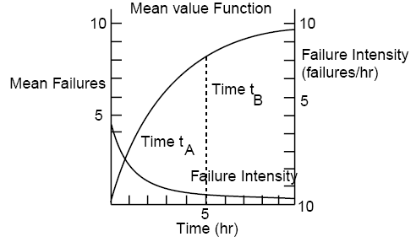
Software Reliability
Fig. 7.3: Mean Value & failure intensity functions.

Slide 16
Software Reliability
Environment
The environment is described by the operational profile. The proportion of runs of various types may vary, depending on the functional environment. Examples of a run type might be:
a particular transaction in an airline reservation system or a business data processing system,
2. a specific cycle in a closed loop control system (for example, in a chemical process industry),
3. a particular service performed by an operating system for a user.

Slide 17
Software Reliability
The run types required of the program by the environment can be viewed as being selected randomly. Thus, we define the operational profile as the set of run types that the program can execute along with possibilities with which they will occur. In fig. 7.4, we show two of many possible input states A and B, with their probabilities of occurrence.
The part of the operational profile for just these two states is shown in fig. 7.5. A realistic operational profile is illustrated in fig.7.6.

Slide 18
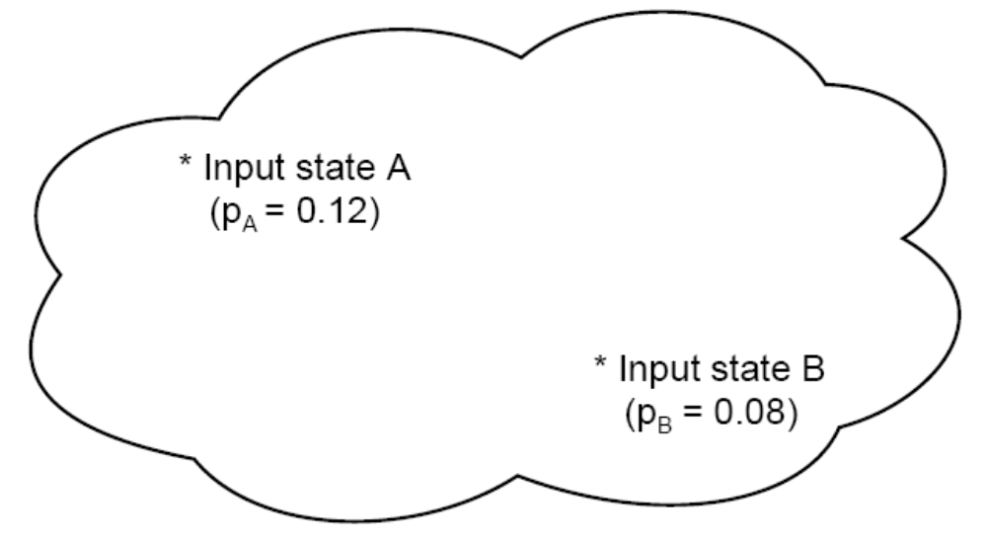
Software Reliability
Fig. 7.4: Input Space

Slide 19
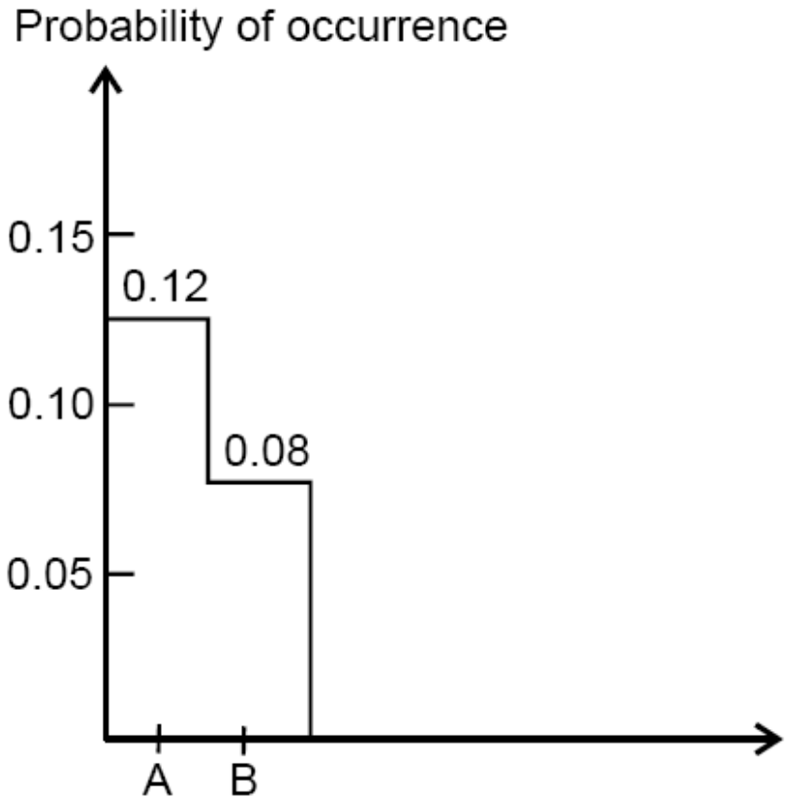
Software Reliability
Fig. 7.5: Portion of operational profile

Slide 20
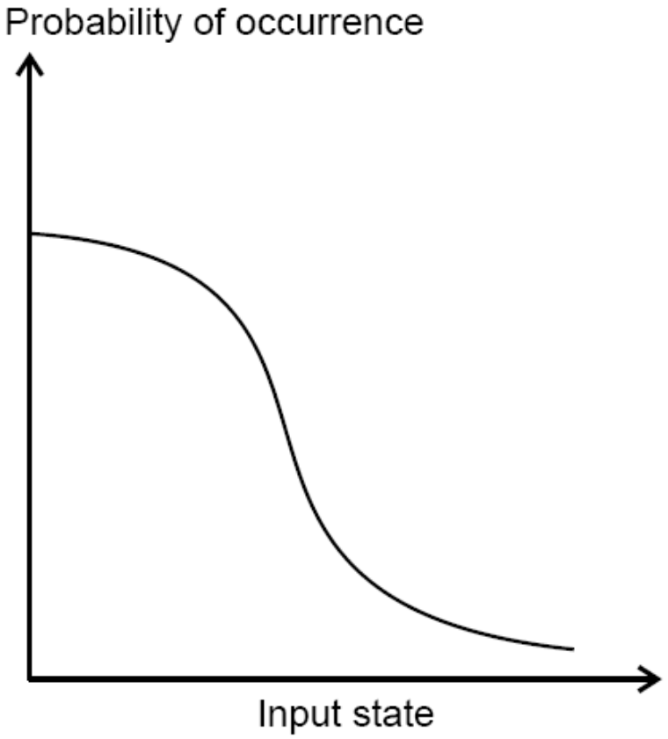
Software Reliability
Fig. 7.6: Operational profile

Slide 21
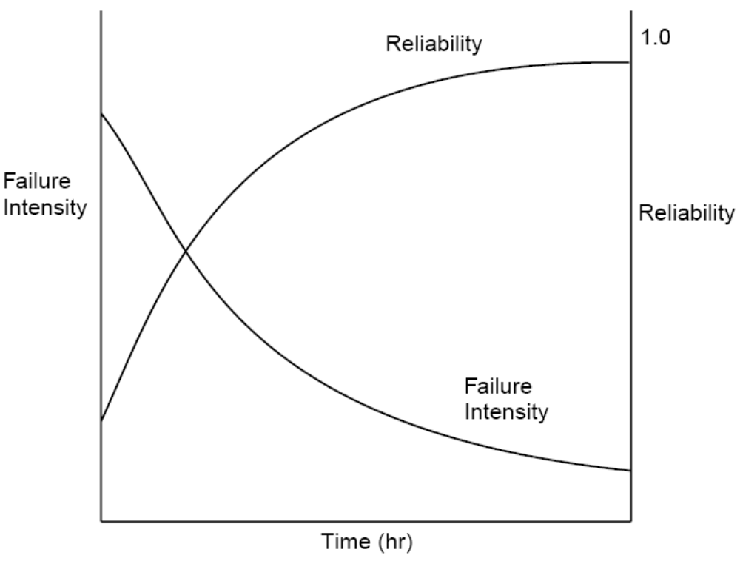
Software Reliability
Fig.7.7 shows how failure intensity and reliability typically vary during a test period, as faults are removed.
Fig. 7.7: Reliability and failure intensity

Slide 22
Software Reliability
Uses of Reliability Studies
There are at least four other ways in which software reliability measures can be of great value to the software engineer, manager or user.
you can use software reliability measures to evaluate software engineering technology quantitatively.
software reliability measures offer you the possibility of evaluating development status during the test phases of a project.

Slide 23
Software Reliability
one can use software reliability measures to monitor the operational performance of software and to control new features added and design changes made to the software.
a quantitative understanding of software quality and the various factors influencing it and affected by it enriches into the software product and the software development process.

Slide 24
Software Reliability
Software Quality
Different people understand different meanings of quality like:
conformance to requirements
fitness for the purpose
level of satisfaction

Slide 25
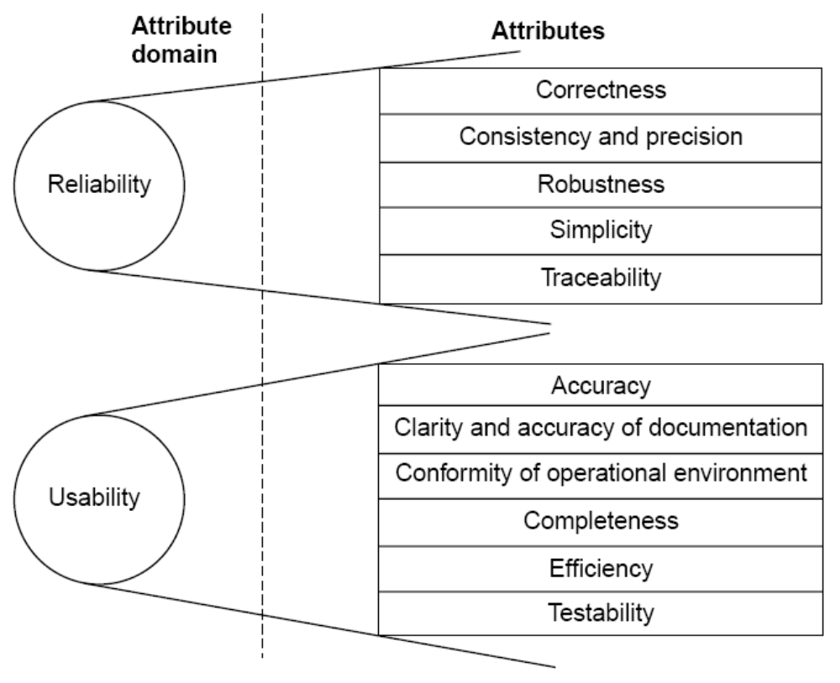
Software Reliability

Slide 26
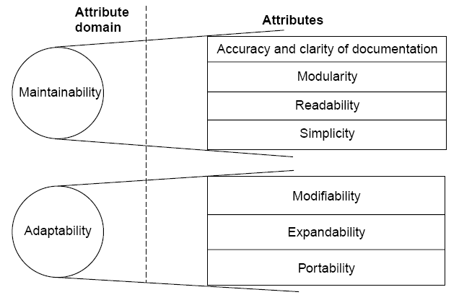
Software Reliability
Fig 7.8: Software quality attributes

Slide 27

Software Reliability
1 | Reliability | The extent to which a software performs its intended functions without failure.
2 | Correctness | The extent to which a software meets its specifications.
3 | Consistency & precision | The extent to which a software is consistent and give results with precision.
4 | Robustness | The extent to which a software tolerates the unexpected problems.
5 | Simplicity | The extent to which a software is simple in its operations.
6 | Traceability | The extent to which an error is traceable in order to fix it.
7 | Usability | The extent of effort required to learn, operate and understand the functions of the software

Slide 28
Software Reliability
8 | Accuracy | Meeting specifications with precision.
9 | Clarity & Accuracy of documentation | The extent to which documents are clearly & accurately written.
10 | Conformity of operational environment | The extent to which a software is in conformity of operational environment.
11 | Completeness | The extent to which a software has specified functions.
12 | Efficiency | The amount of computing resources and code required by software to perform a function.
13 | Testability | The effort required to test a software to ensure that it performs its intended functions.
14 | Maintainability | The effort required to locate and fix an error during maintenance phase.

Slide 29
Software Reliability
15 | Modularity | It is the extent of ease to implement, test, debug and maintain the software.
16 | Readability | The extent to which a software is readable in order to understand.
17 | Adaptability | The extent to which a software is adaptable to new platforms & technologies.
18 | Modifiability | The effort required to modify a software during maintenance phase.
19 | Expandability | The extent to which a software is expandable without undesirable side effects.
20 | Portability | The effort required to transfer a program from one platform to another platform.
Table 7.4: Software quality attributes

Slide 30
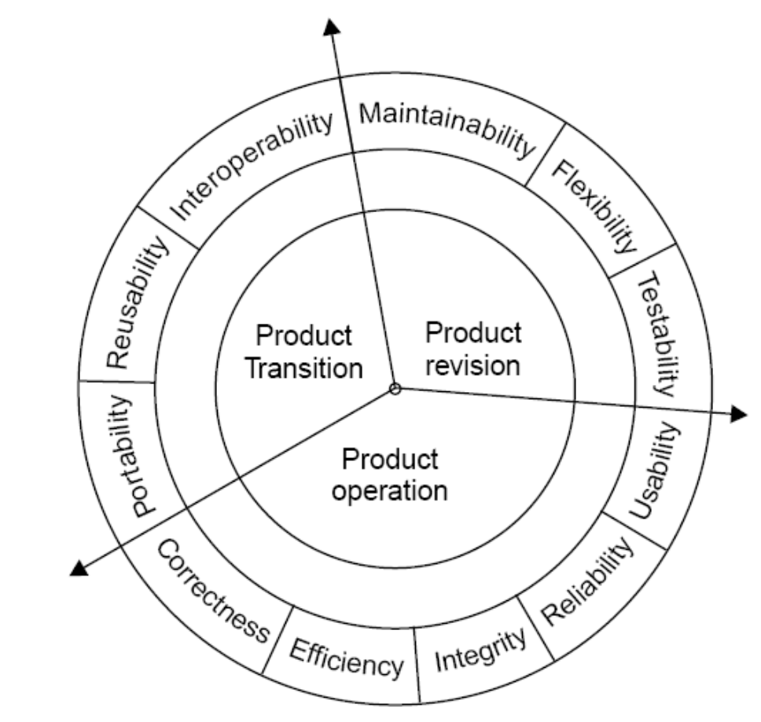
Software Reliability
McCall Software Quality Model
Fig 7.9: Software quality factors

Slide 31
Software Reliability
Product Operation
Factors which are related to the operation of a product are combined. The factors are:
Correctness
Efficiency
Integrity
Reliability
Usability
These five factors are related to operational performance, convenience, ease of usage and its correctness. These factors play a very significant role in building customer’s satisfaction.

Slide 32
Software Reliability
Product Revision
The factors which are required for testing & maintenance are combined and are given below:
Maintainability
Flexibility
Testability
These factors pertain to the testing & maintainability of software. They give us idea about ease of maintenance, flexibility and testing effort. Hence, they are combined under the umbrella of product revision.

Slide 33
Software Reliability
Product Transition
We may have to transfer a product from one platform to an other platform or from one technology to another technology. The factors related to such a transfer are combined and given below:
Portability
Reusability
Interoperability

Slide 34
Software Reliability
Most of the quality factors are explained in table 7.4. The remaining factors are given in table 7.5.
Sr.No. | Quality Factors | Purpose
1 | Integrity | The extent to which access to software or data by the unauthorized persons can be controlled.
2 | Flexibility | The effort required to modify an operational program.
3 | Reusability | The extent to which a program can be reused in other applications.
4 | Interoperability | The effort required to couple one system with another.
Table 7.5: Remaining quality factors (other are in table 7.4)

Slide 35
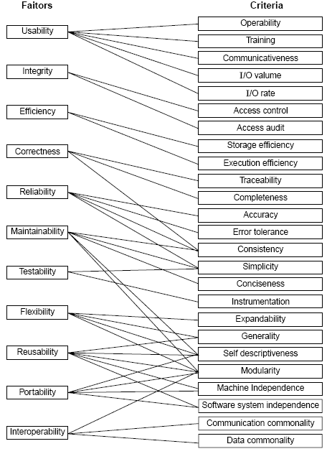
Quality criteria
Fig 7.10: McCall’s quality model

Slide 36
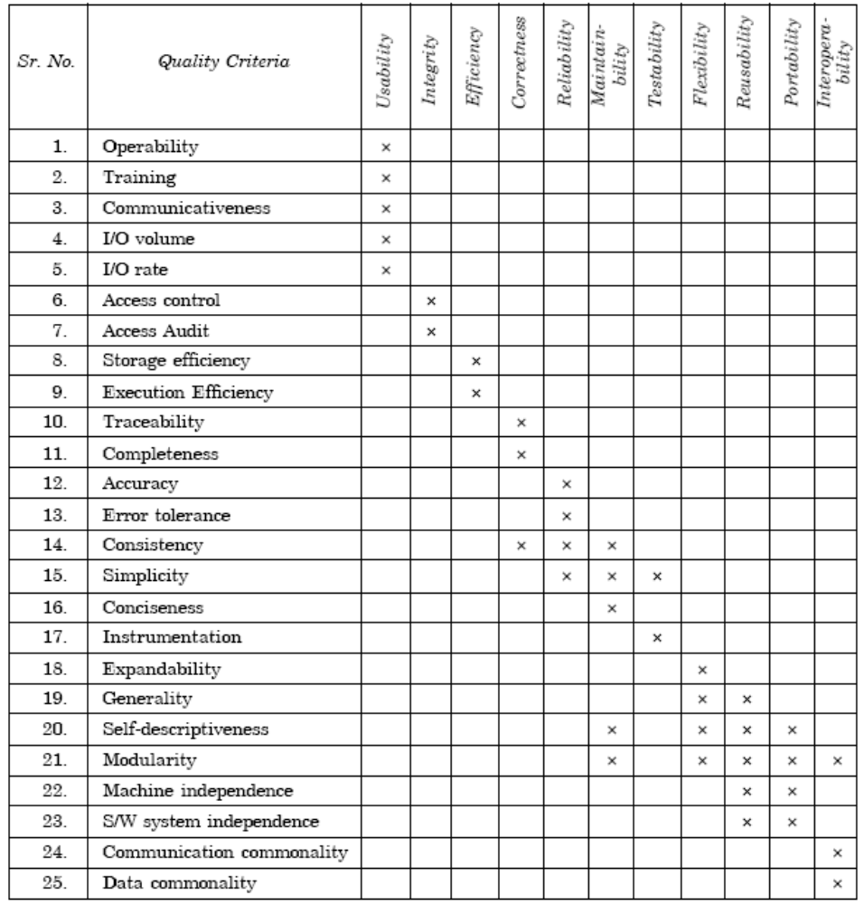
Software Reliability
Table 7.5(a): Relation between quality factors and quality criteria

Slide 37
Software Reliability
1 | Operability | The ease of operation of the software.
2 | Training | The ease with which new users can use the system.
3 | Communicativeness | The ease with which inputs and outputs can be assimilated.
4 | I/O volume | It is related to the I/O volume.
5 | I/O rate | It is the indication of I/O rate.
6 | Access control | The provisions for control and protection of the software and data.
7 | Access audit | The ease with which software and data can be checked for compliance with standards or other requirements.
8 | Storage efficiency | The run time storage requirements of the software.
9 | Execution efficiency | The run-time efficiency of the software.

Slide 38
Software Reliability
10 | Traceability | The ability to link software components to requirements.
11 | Completeness | The degree to which a full implementation of the required functionality has been achieved.
12 | Accuracy | The precision of computations and output.
13 | Error tolerance | The degree to which continuity of operation is ensured under adverse conditions.
14 | Consistency | The use of uniform design and implementation techniques and notations throughout a project.
15 | Simplicity | The ease with which the software can be understood.
16 | Conciseness | The compactness of the source code, in terms of lines of code.
17 | Instrumentation | The degree to which the software provides for measurements of its use or identification of errors.

Slide 39
Software Reliability
18 | Expandability | The degree to which storage requirements or software functions can be expanded.
19 | Generability | The breadth of the potential application of software components.
20 | Self-descriptiveness | The degree to which the documents are self explanatory.
21 | Modularity | The provision of highly independent modules.
22 | Machine independence | The degree to which software is dependent on its associated hardware.
23 | Software system independence | The degree to which software is independent of its environment.
24 | Communication commonality | The degree to which standard protocols and interfaces are used.
25 | Data commonality | The use of standard data representations.
Table 7.5 (b): Software quality criteria

Slide 40
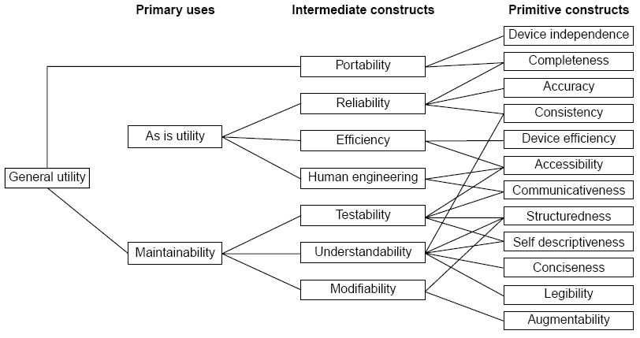
Software Reliability
Boehm Software Quality Model
Fig.7.11: The Boehm software quality model

Slide 41
Software Reliability
ISO 9126
Functionality
Reliability
Usability
Efficiency
Maintainability
Portability

Slide 42
Software Reliability
Characteristic/ Attribute | Short Description of the Characteristics and the concerns Addressed by Attributes
Functionality | Characteristics relating to achievement of the basic purpose for which the software is being engineered
Suitability | The presence and appropriateness of a set of functions for specified tasks
Accuracy | The provision of right or agreed results or effects
Interoperability | Software’s ability to interact with specified systems
Security | Ability to prevent unauthorized access, whether accidental or deliberate, to program and data.
Reliability | Characteristics relating to capability of software to maintain its level of performance under stated conditions for a stated period of time
Maturity | Attributes of software that bear on the frequency of failure by faults in the software

Slide 43
Software Reliability
Fault tolerance | Ability to maintain a specified level of performance in cases of software faults or unexpected inputs
Recoverability | Capability and effort needed to reestablish level of performance and recover affected data after possible failure.
Usability | Characteristics relating to the effort needed for use, and on the individual assessment of such use, by a stated implied set of users.
Understandability | The effort required for a user to recognize the logical concept and its applicability.
Learnability | The effort required for a user to learn its application, operation, input and output.
Operability | The ease of operation and control by users.
Efficiency | Characteristic related to the relationship between the level of performance of the software and the amount of resources used, under stated conditions.

Slide 44
Software Reliability
Time behavior | The speed of response and processing times and throughout rates in performing its function.
Resource behavior | The amount of resources used and the duration of such use in performing its function.
Maintainability | Characteristics related to the effort needed to make modifications, including corrections, improvements or adaptation of software to changes in environment, requirements and functions specifications.
Analyzability | The effort needed for diagnosis of deficiencies or causes of failures, or for identification of parts to be modified.
Changeability | The effort needed for modification, fault removal or for environmental change.
Stability | The risk of unexpected effect of modifications.
Testability | The effort needed for validating the modified software.

Slide 45
Software Reliability
Portability | Characteristics related to the ability to transfer the software from one organization or hardware or software environment to another.
Adaptability | The opportunity for its adaptation to different specified environments.
Installability | The effort needed to install the software in a specified environment.
Conformance | The extent to which it adheres to standards or conventions relating to portability.
Replaceability | The opportunity and effort of using it in the place of other software in a particular environment.
Table 7.6: Software quality characteristics and attributes – The ISO 9126 view

Slide 46
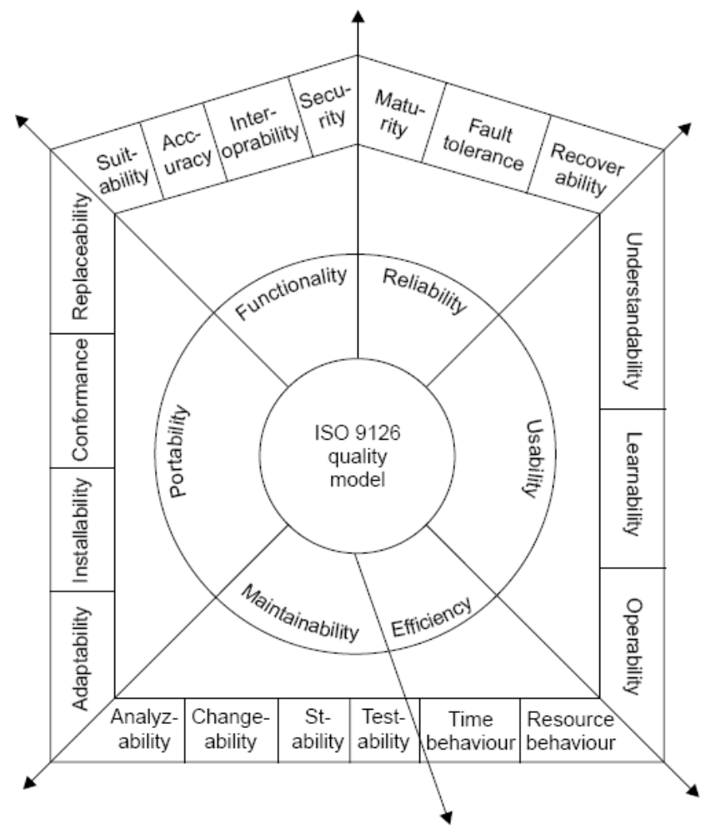
Software Reliability
Fig.7.12: ISO 9126 quality model

Slide 47
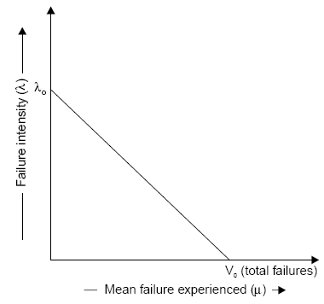
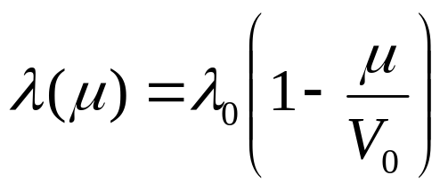
Software Reliability
Software Reliability Models
Basic Execution Time Model
(1)
Fig.7.13: Failure intensity λ as a function of μ for basic model

Slide 48
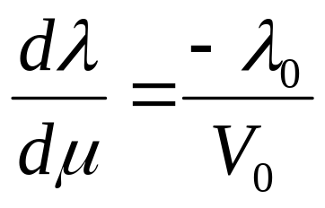
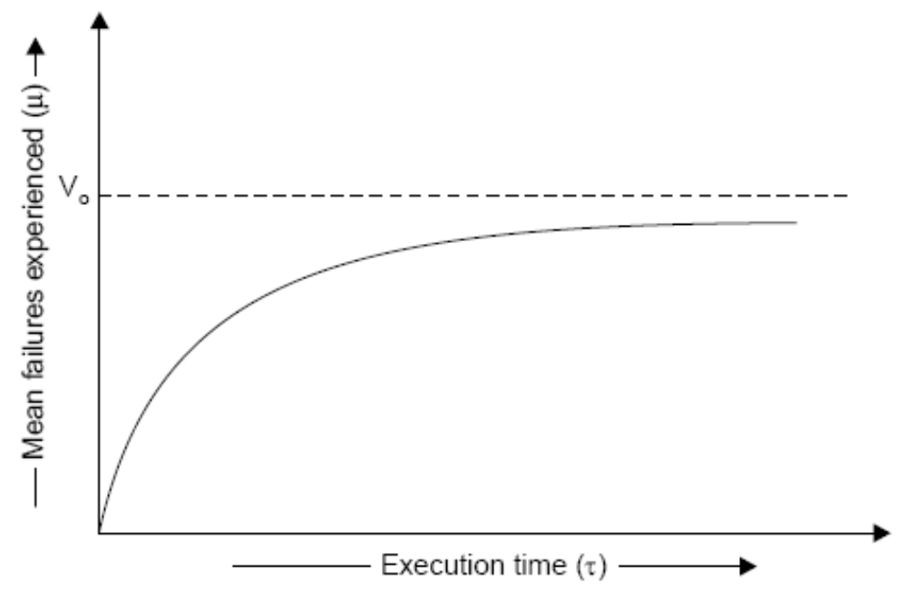

Software Reliability
(2)
Fig.7.14: Relationship between & μ for basic model

Slide 49
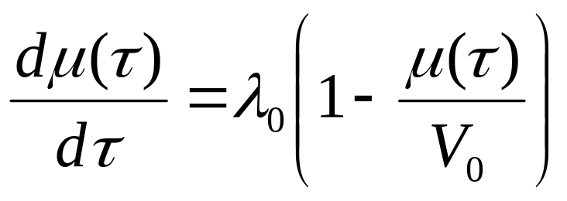

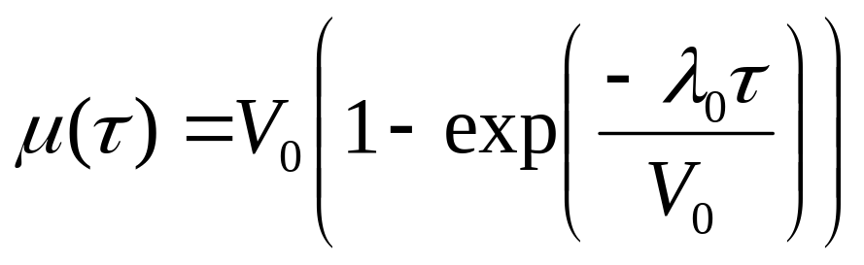
Software Reliability
For a derivation of this relationship, equation 1 can be written as:
The above equation can be solved for
and result in :
(3)

Slide 50
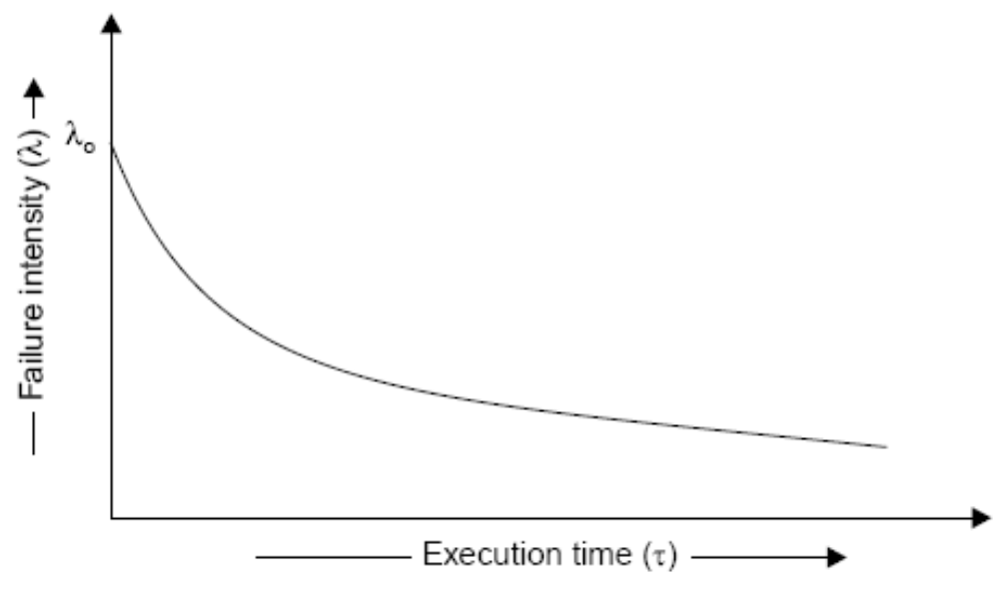
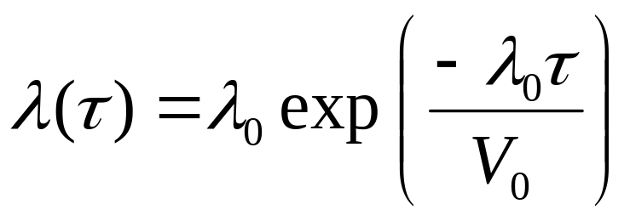
Software Reliability
The failure intensity as a function of execution time is shown in figure given below
Fig.7.15: Failure intensity versus execution time for basic model

Slide 51
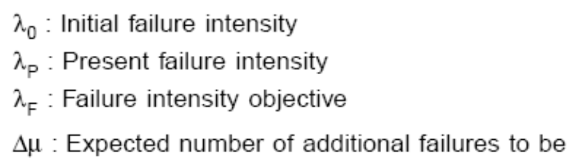
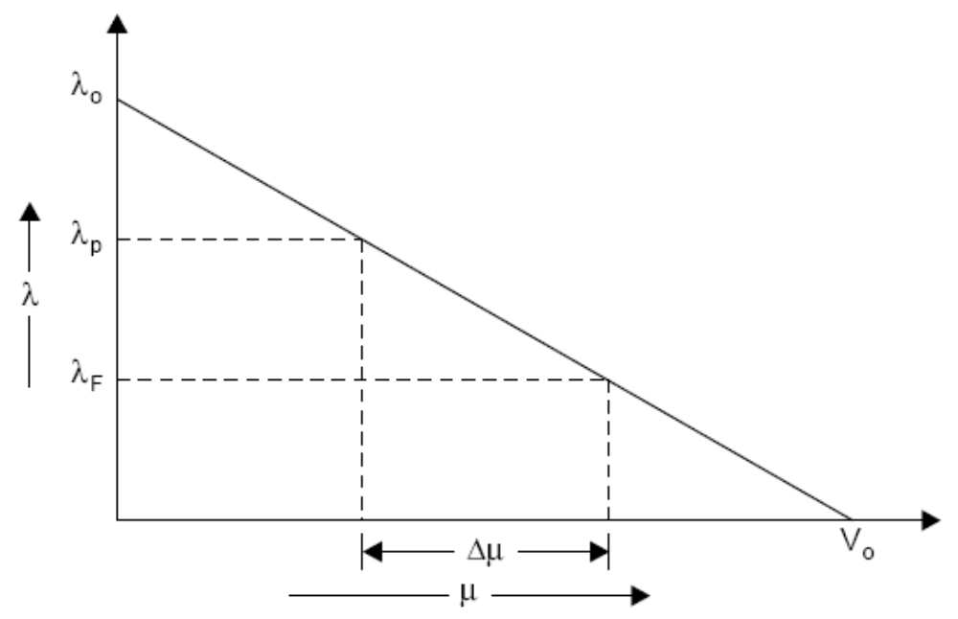
Software Reliability
Derived quantities
Fig.7.16: Additional failures required to be experienced to reach the objective

Slide 52
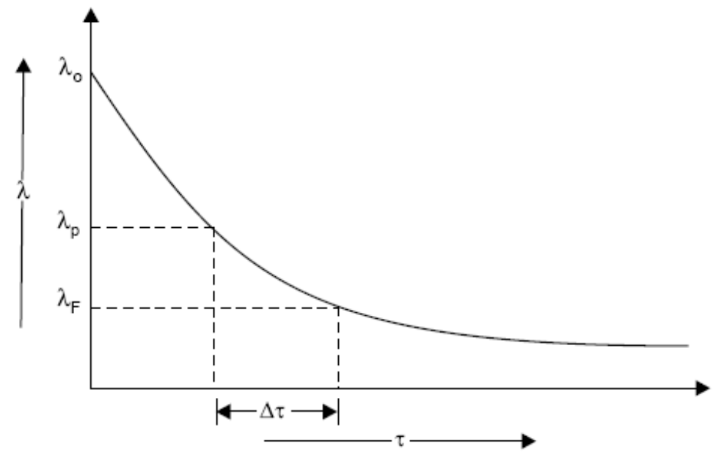
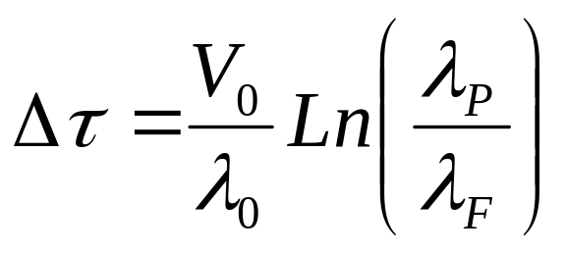
Software Reliability
Fig.7.17: Additional time required to reach the objective
This can be derived in mathematical form as:

Slide 53
Software Reliability
Example- 7.1
Assume that a program will experience 200 failures in infinite time. It has now experienced 100. The initial failure intensity was 20 failures/CPU hr.
Determine the current failure intensity.
Find the decrement of failure intensity per failure.
Calculate the failures experienced and failure intensity after 20 and 100 CPU hrs. of execution.
Compute addition failures and additional execution time required to reach the failure intensity objective of 5 failures/CPU hr.
Use the basic execution time model for the above mentioned calculations.

Slide 54
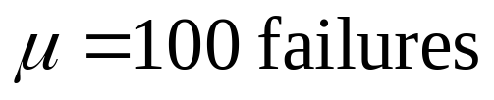
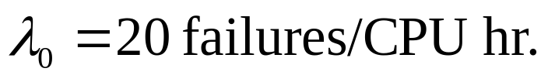
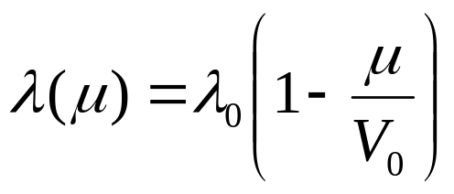
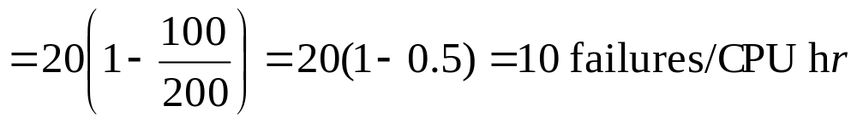
Software Reliability
Solution
Here V_{o}=200 failures
(i) Current failure intensity:

Slide 55
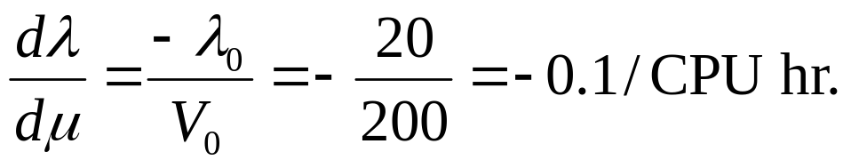

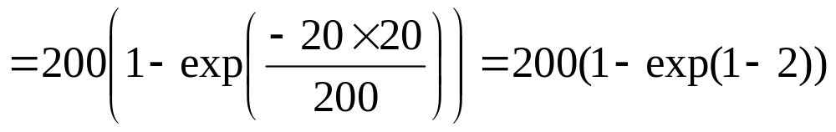

Software Reliability
(ii) Decrement of failure intensity per failure can be calculated as:
(iii) (a) Failures experienced & failure intensity after 20 CPU hr:

Slide 56
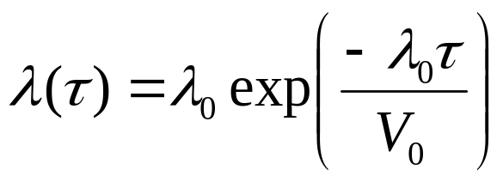
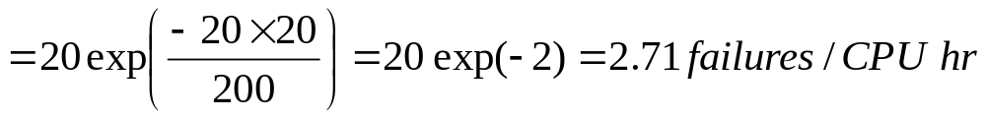
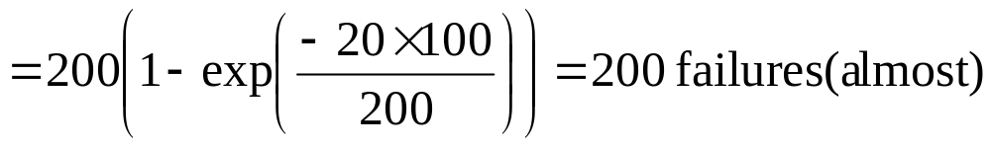
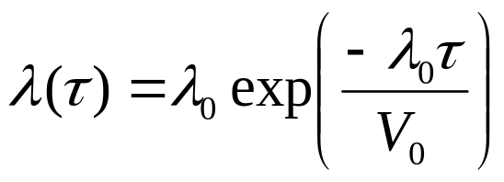
Software Reliability
(b) Failures experienced & failure intensity after 100 CPU hr:

Slide 57
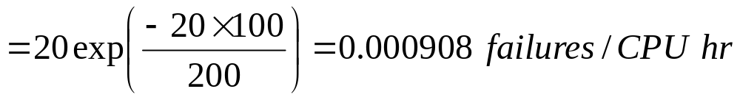

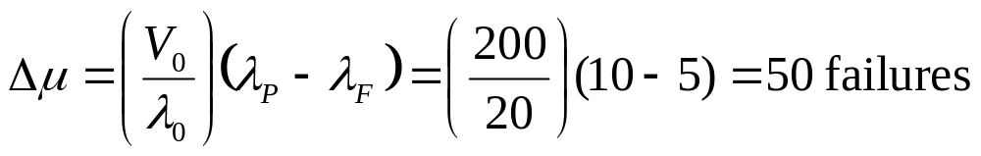
Software Reliability
(iv) Additional failures required to reach the failure intensity objective of 5 failures/CPU hr.

Slide 58
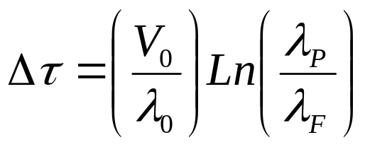
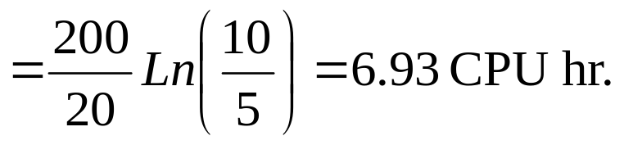
Software Reliability
Additional execution time required to reach failure intensity objective of 5 failures/CPU hr.

Slide 59

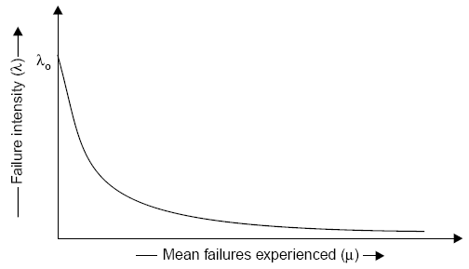

Software Reliability
Logarithmic Poisson Execution Time Model
Failure Intensity
Fig.7.18: Relationship between

Slide 60
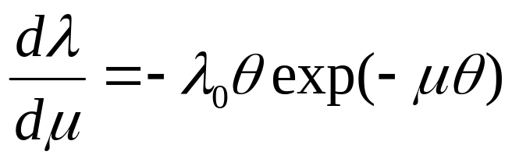
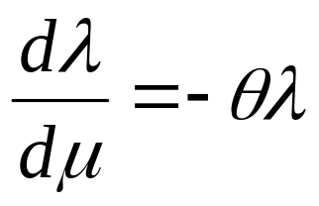
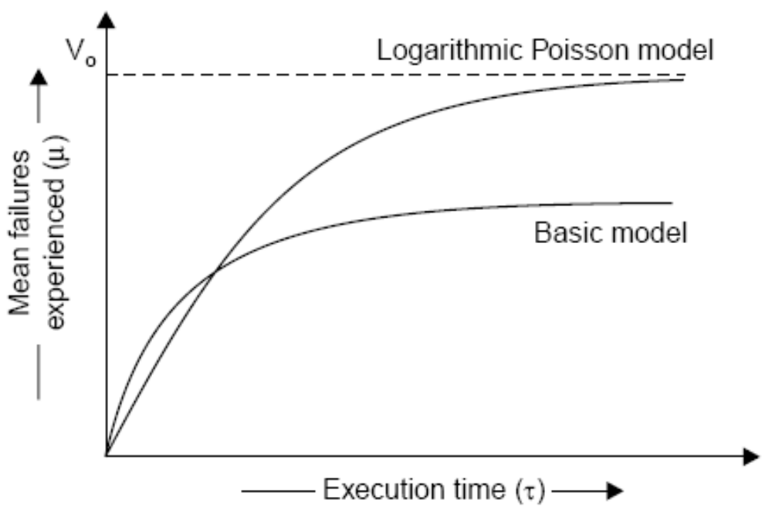
Software Reliability
Fig.7.19: Relationship between

Slide 61
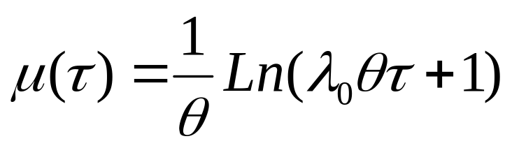

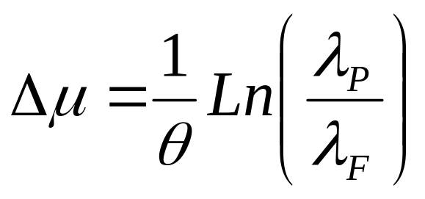
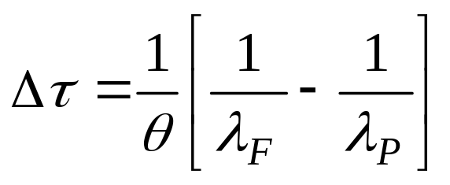
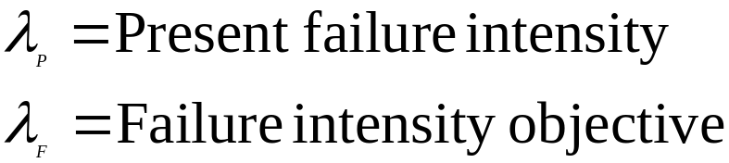
Software Reliability
(4)

Slide 62
Software Reliability
Example- 7.2
Assume that the initial failure intensity is 20 failures/CPU hr. The failure intensity decay parameter is 0.02/failures. We have experienced 100 failures up to this time.
Determine the current failure intensity.
Calculate the decrement of failure intensity per failure.
Find the failures experienced and failure intensity after 20 and 100 CPU hrs. of execution.
Compute the additional failures and additional execution time required to reach the failure intensity objective of 2 failures/CPU hr.
Use Logarithmic Poisson execution time model for the above mentioned calculations.

Slide 63
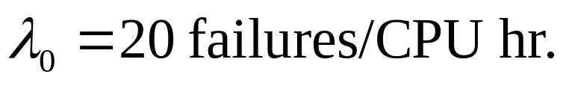

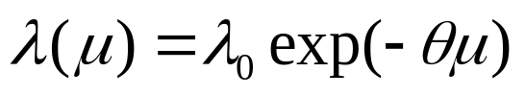
Software Reliability
Solution
(i) Current failure intensity:
= 20 exp (-0.02 x 100)
= 2.7 failures/CPU hr.

Slide 64



Software Reliability
(ii) Decrement of failure intensity per failure can be calculated as:
= -.02 x 2.7 = -.054/CPU hr.
(iii) (a) Failures experienced & failure intensity after 20 CPU hr:

Slide 65


Software Reliability
(b) Failures experienced & failure intensity after 100 CPU hr:

Slide 66


Software Reliability
(iv) Additional failures required to reach the failure intensity objective of 2 failures/CPU hr.

Slide 67




Software Reliability
Example- 7.3
The following parameters for basic and logarithmic Poisson models are given:
Determine the addition failures and additional execution time required to reach the failure intensity objective of 5 failures/CPU hr. for both models.
Repeat this for an objective function of 0.5 failure/CPU hr. Assume that we start with the initial failure intensity only.
Basic execution time model | Logarithmic Poisson execution time model

Slide 68





Software Reliability
Solution
(a) (i) Basic execution time model
(Present failure intensity) in this case is same as (initial failure intensity).
Now,

Slide 69





Software Reliability
(ii) Logarithmic execution time model

Slide 70





Software Reliability
Logarithmic model has calculated more failures in almost some duration of execution time initially.
(b) Failure intensity objective = 0.5 failures/CPU hr.
(i) Basic execution time model

Slide 71




Software Reliability
(ii) Logarithmic execution time model

Slide 72
Software Reliability
Calendar Time Component
The calendar time component is based on a debugging process model. This model takes into account:
resources used in operating the program for a given execution time and processing an associated quantity of failure.
resources quantities available, and
the degree to which a resource can be utilized (due to bottlenecks) during the period in which it is limiting.
Table 7.7 will help in visualizing these different aspects of the resources, and the parameters that result.

Slide 73
Software Reliability
Resource usage
 | Usage parameters requirements per |  | Planned parameters
Resource | CPU hr | Failure | Quantities available | Utilisation
Failure identification personnel | θ_{I} | μ_{I} | P_{I} | 1
Failure correction personnel | 0 | μ_{f} | P_{f} | P_{f}
Computer time | θc | μ_{c} | P_{c} | P_{c}
Fig. : Calendar time component resources and parameters

Slide 74




Software Reliability
Hence, to be more precise, we have
(for computer time)
(for failure correction)
(for failure identification)

Slide 75


Software Reliability
Calendar time to execution time relationship

Slide 76

Software Reliability
Fig.7.20: Instantaneous calendar time to execution time ratio

Slide 77

Software Reliability
Fig.7.21: Calendar time to execution time ratio for different limiting resources

Slide 78
Software Reliability
Example- 7.4
A team run test cases for 10 CPU hrs and identifies 25 failures. The effort required per hour of execution time is 5 person hr. Each failure requires 2 hr. on an average to verify and determine its nature. Calculate the failure identification effort required.

Slide 79





Software Reliability
Solution
As we know, resource usage is:
Hence,
X_{r} = 5 (10) + 2 (25)
= 50 + 50 = 100 person hr.

Slide 80


Software Reliability
Example- 7.5
Initial failure intensity for a given software is 20 failures/CPU hr. The failure intensity objective of 1 failure/CPU hr. is to be achieved. Assume the following resource usage parameters.
Resource Usage | Per hour | Per failure
Failure identification effort | 2 Person hr. | 1 Person hr.
Failure Correction effort | 0 | 5 Person hr.
Computer time | 1.5 CPU hr. | 1 CPU hr.

Slide 81
Software Reliability
What resources must be expended to achieve the reliability improvement? Use the logarithmic Poisson execution time model with a failure intensity decay parameter of 0.025/failure.
If the failure intensity objective is cut to half, what is the effect on requirement of resources ?

Slide 82




Software Reliability
Solution
(a)

Slide 83



Software Reliability
Hence
= 1 (119) + 2 (38) = 195 Person hrs.
= 5 (119) = 595 Person hrs.
= 1 (119) + (1.5) (38) = 176 CPU hr.

Slide 84



Software Reliability
(b)
So,
X_{I} = 1 (148) + 2 (78) = 304 Person hrs.
X_{F} = 5 (148) = 740 Person hrs.
X_{C} = 1 (148) + (1.5)(78) = 265 CPU hrs.

Slide 85

Software Reliability
Hence, if we cut failure intensity objective to half, resources requirements are not doubled but they are some what less. Note that is approximately doubled but increases logarithmically. Thus, the resources increase will be between a logarithmic increase and a linear increase for changes in failure intensity objective.

Slide 86
Software Reliability
Example- 7.6
A program is expected to have 500 faults. It is also assumed that one fault may lead to one failure only. The initial failure intensity was 2 failures/CPU hr. The program was to be released with a failure intensity objective of 5 failures/100 CPU hr. Calculated the number of failure experienced before release.

Slide 87




Software Reliability
Solution
The number of failure experienced during testing can be calculated using the equation mentioned below:

Slide 88

Software Reliability
So
= 487 failures
Hence 13 faults are expected to remain at the release instant of the software.

Slide 89

Software Reliability
The Jelinski-Moranda Model
where
  φ = Constant of proportionality
  N = Total number of errors present
  I = number of errors found by time interval t_{i}

Slide 90

Software Reliability
Fig.7.22: Relation between t & λ

Slide 91
Software Reliability
Example- 7.7
There are 100 errors estimated to be present in a program. We have experienced 60 errors. Use Jelinski-Moranda model to calculate failure intensity with a given value of φ=0.03. What will be failure intensity after the experience of 80 errors?

Slide 92

Software Reliability
Solution
N = 100 errors
i = 60 failures
φ = 0.03
We know
= 0.03(100-60+1)
= 1.23 failures/CPU hr.
After 80 failures
= 0.63 failures/CPU hr.
Hence, there is continuous decrease in the failure intensity as the number of failure experienced increases.

Slide 93



Software Reliability
The Bug Seeding Model
The bug seeding model is an outgrowth of a technique used to estimate the number of animals in a wild life population or fish in a pond.

Slide 94

Software Reliability
Capability Maturity Model
It is a strategy for improving the software process, irrespective of the actual life cycle model used.
Fig.7.23: Maturity levels of CMM

Slide 95
Software Reliability
Maturity Levels:
  Initial (Maturity Level 1)
  Repeatable (Maturity Level 2)
  Defined (Maturity Level 3)
  Managed (Maturity Level 4)
  Optimizing (Maturity Level 5)

Slide 96
Software Reliability
Maturity Level | Characterization
Initial | Adhoc Process
Repeatable | Basic Project Management
Defined | Process Definition
Managed | Process Measurement
Optimizing | Process Control
Fig.7.24: The five levels of CMM

Slide 97

Software Reliability
Key Process Areas
The key process areas at level 2 focus on the software project’s concerns related to establishing basic project management controls, as summarized below:

Slide 98


Software Reliability
The key process areas at level 3 address both project and organizational issues, as summarized below:

Slide 99

Software Reliability

Slide 100

Software Reliability
The key process areas at level 4 focus on establishing a quantitative understanding of both the software process and the software work products being built, as summarized below:

Slide 101

Software Reliability
The key process areas at level 5 cover the issues that both the organization and the projects must address to implement continuous and measurable software process improvement, as summarized below:

Slide 102

Software Reliability
Common Features

Slide 103
Software Reliability
ISO 9000
The SEI capability maturity model initiative is an attempt to improve software quality by improving the process by which software is developed.
ISO-9000 series of standards is a set of document dealing with quality systems that can be used for quality assurance purposes. ISO-9000 series is not just software standard. It is a series of five related standards that are applicable to a wide variety of industrial activities, including design/ development, production, installation, and servicing. Within the ISO 9000 Series, standard ISO 9001 for quality system is the standard that is most applicable to software development.

Slide 104
Software Reliability
Mapping ISO 9001 to the CMM
  Management responsibility
  2. Quality system
  3. Contract review
  4. Design control
  5. Document control
  6. Purchasing
  7. Purchaser-supplied product

Slide 105
Software Reliability
  8. Product identification and traceability
  9. Process control
  10. Inspection and testing
  11. Inspection, measuring and test equipment
  12. Inspection and test status
  13. Control of nonconforming product
  14. Corrective action

Slide 106
Software Reliability
  15. Handling, storage, packaging and delivery
  16. Quality records
  17. Internal quality audits
  18. Training
  19. Servicing
  20. Statistical techniques

Slide 107
Software Reliability
Contrasting ISO 9001 and the CMM
There is a strong correlation between ISO 9001 and the CMM, although some issues in ISO 9001 are not covered in the CMM, and some issues in the CMM are not addressed in ISO 9001.
The biggest difference, however, between these two documents is the emphasis of the CMM on continuous process improvement.
The biggest similarity is that for both the CMM and ISO 9001, the bottom line is “Say what you do; do what you say”.

Slide 108
Multiple Choice Questions
Note: Choose most appropriate answer of the following questions:
7.1 Which one is not a phase of “bath tub curve” of hardware reliability
(a) Burn-in (b) Useful life
(c) Wear-out (d) Test-out
7.2 Software reliability is
(a) the probability of failure free operation of a program for a specified time in a specified environment
(b) the probability of failure of a program for a specified time in a specified environment
(c) the probability of success of a program for a specified time in any environment
(d) None of the above
7.3 Fault is
(a) Defect in the program (b) Mistake in the program
(c) Error in the program (d) All of the above
7.4 One fault may lead to
(a) one failure (b) two failures
(c) many failures (d) all of the above

Slide 109
Multiple Choice Questions
7.5 Which ‘time’ unit is not used in reliability studies
(a) Execution time (b) Machine time
(c) Clock time (d) Calendar time
7.6 Failure occurrences can be represented as
(a) time to failure (b) time interval between failures
(c) failures experienced in a time interval (d) All of the above
7.7 Maximum possible value of reliability is
(a) 100 (b) 10
(c) 1 (d) 0
7.8 Minimum possible value of reliability is
(a) 100 (b) 10
(c) 1 (d) 0
7.9 As the reliability increases, failure intensity
(a) decreases (b) increases
(c) no effect (d) None of the above

Slide 110
Multiple Choice Questions
7.10 If failure intensity is 0.005 failures/hour during 10 hours of operation of a software, its reliability can be expressed as
(a) 0.10 (b) 0.92
(c) 0.95 (d) 0.98
7.11 Software Quality is
(a) Conformance to requirements (b) Fitness for the purpose
(c) Level of satisfaction (d) All of the above
7.12 Defect rate is
(a) number of defects per million lines of source code (b) number of defects per function point
(c) number of defects per unit of size of software
(d) All of the above
7.13 How many product quality factors have been proposed in McCall quality model?
(a) 2 (b) 3
(c) 11 (d) 6

Slide 111
Multiple Choice Questions
7.14 Which one is not a product quality factor of McCall quality model?
(a) Product revision (b) Product operation
(c) Product specification (d) Product transition
7.15 The second level of quality attributes in McCall quality model are termed as
(a) quality criteria (b) quality factors
(c) quality guidelines (d) quality specifications
7.16 Which one is not a level in Boehm software quality model ?
(a) Primary uses (b) Intermediate constructs
(c) Primitive constructs (d) Final constructs
7.17 Which one is not a software quality model?
(a) McCall model (b) Boehm model
(c) ISO 9000 (d) ISO 9126
7.18 Basic execution time model was developed by
(a) Bev.Littlewood (b) J.D.Musa
(c) R.Pressman (d) Victor Baisili

Slide 112









Multiple Choice Questions
7.19 NHPP stands for
(a) Non Homogeneous Poisson Process (b) Non Hetrogeneous Poisson Process
(c) Non Homogeneous Poisson Product (d) Non Hetrogeneous Poisson Product
7.20 In Basic execution time model, failure intensity is given by
7.21 In Basic execution time model, additional number of failures required to achieve a failure intensity objective is expressed as

Slide 113









Multiple Choice Questions
7.22 In Basic execution time model, additional time required to achieve a failure intensity objective is given as
7.23 Failure intensity function of Logarithmic Poisson execution model is given as
7.24 In Logarithmic Poisson execution model, ‘θ’ is known as
(a) Failure intensity function parameter (b) Failure intensity decay parameter
(c) Failure intensity measurement (d) Failure intensity increment parameter

Slide 114




Multiple Choice Questions
7.25 In jelinski-Moranda model, failure intensity is defined aseneous Poisson Product
7.26 CMM level 1 has
(a) 6 KPAs (b) 2 KPAs
(c) 0 KPAs (d) None of the above
7.27 MTBF stands for
(a) Mean time between failure (b) Maximum time between failures
(c) Minimum time between failures (d) Many time between failures
7.28 CMM model is a technique to
(a) Improve the software process (b) Automatically develop the software
(c) Test the software (d) All of the above
7.29 Total number of maturing levels in CMM are
(a) 1 (b) 3
(c) 5 (d) 7

Slide 115
Multiple Choice Questions
7.30 Reliability of a software is dependent on number of errors
(a) removed (b) remaining
(c) both (a) & (b) (d) None of the above
7.31 Reliability of software is usually estimated at
(a) Analysis phase (b) Design phase
(c) Coding phase (d) Testing phase
7.32 CMM stands for
(a) Capacity maturity model (b) Capability maturity model
(c) Cost management model (d) Comprehensive maintenance model
7.33 Which level of CMM is for basic project management?
(a) Initial (b) Repeatable
(c) Defined (d) Managed
7.34 Which level of CMM is for process management?
(a) Initial (b) Repeatable
(c) Defined (d) Optimizing

Slide 116
Multiple Choice Questions
7.35 Which level of CMM is for process management?
(a) Initial (b) Defined
(c) Managed (d) Optimizing
7.36 CMM was developed at
(a) Harvard University (b) Cambridge University
(c) Carnegie Mellon University (d) Maryland University
7.37 McCall has developed a
(a) Quality model (b) Process improvement model
(c) Requirement model (d) Design model
7.38 The model to measure the software process improvement is called
(a) ISO 9000 (b) ISO 9126
(c) CMM (d) Spiral model
7.39 The number of clauses used in ISO 9001 are
(a) 15 (b) 25
(c) 20 (d) 10

Slide 117
Multiple Choice Questions
7.40 ISO 9126 contains definitions of
(a) quality characteristics (b) quality factors
(c) quality attributes (d) All of the above
7.41 In ISO 9126, each characteristics is related to
(a) one attributes (b) two attributes
(c) three attributes (d) four attributes
7.42 In McCall quality model; product revision quality factor consist of
(a) Maintainability (b) Flexibility
(c) Testability (d) None of the above
7.43 Which is not a software reliability model ?
(a) The Jelinski-Moranda Model (b) Basic execution time model
(c) Spiral model (d) None of the above
7.44 Each maturity model is CMM has
(a) One KPA (b) Equal KPAs
(c) Several KPAs (d) no KPA

Slide 118
Multiple Choice Questions
7.45 KPA in CMM stands for
(a) Key Process Area (b) Key Product Area
(c) Key Principal Area (d) Key Performance Area
7.46 In reliability models, our emphasis is on
(a) errors (b) faults
(c) failures (d) bugs
7.47 Software does not break or wear out like hardware. What is your opinion?
(a) True (b) False
(c) Can not say (d) not fixed
7.48 Software reliability is defined with respect to
(a) time (b) speed
(c) quality (d) None of the above
7.49 MTTF stands for
(a) Mean time to failure (b) Maximum time to failure
(c) Minimum time to failure (d) None of the above

Slide 119
Multiple Choice Questions
7.50 ISO 9000 is a series of standards for quality management systems and has
(a) 2 related standards (b) 5 related standards
(c) 10 related standards (d) 25 related standards

Slide 120
Exercises
7.1 What is software reliability? Does it exist?
7.2 Explain the significance of bath tube curve of reliability with the help of a diagram.
7.3 Compare hardware reliability with software reliability.
7.4 What is software failure? How is it related with a fault?
7.5 Discuss the various ways of characterising failure occurrences with respect to time.
7.6 Describe the following terms:
(i) Operational profile (ii) Input space
(iii) MTBF (iv) MTTF
(v) Failure intensity.

Slide 121
Exercises
7.7 What are uses of reliability studies? How can one use software reliability measures to monitor the operational performance of software?
7.8 What is software quality? Discuss software quality attributes.
7.9 What do you mean by software quality standards? Illustrate their essence as well as benefits.
7.10 Describe the McCall software quality model. How many product quality factors are defined and why?
7.11 Discuss the relationship between quality factors and quality criteria in McCall’s software quality model.
7.12 Explain the Boehm software quality model with the help of a block diagram.
7.13 What is ISO9126 ? What are the quality characteristics and attributes?

Slide 122

Exercises
7.14 Compare the ISO9126 with McCall software quality model and highlight few advantages of ISO9126.
7.15 Discuss the basic model of software reliability. How can be calculated.
7.16 Assume that the initial failure intensity is 6 failures/CPU hr. The failure intensity decay parameter is 0.02/failure. We assume that 45 failures have been experienced. Calculate the current failure intensity.
7.17 Explain the basic & logarithmic Poisson model and their significance in reliability studies.

Slide 123

Exercises
7.18 Assume that a program will experience 150 failures in infinite time. It has now experienced 80. The initial failure intensity was 10 failures/CPU hr.
(i) Determine the current failure intensity
(ii) Calculate the failures experienced and failure intensity after 25 and 40 CPU hrs. of execution.
(iii) Compute additional failures and additional execution time required to reach the failure intensity objective of 2 failures/CPU hr.
Use the basic execution time model for the above mentioned calculations.
7.19 Write a short note on Logarithmic Poisson Execution time model. How can we calculate
7.20 Assume that the initial failure intensity is 10 failures/CPU hr. The failure intensity decay parameter is 0.03/failure. We have experienced 75 failures upto this time. Find the failures experienced and failure intensity after 25 and 50 CPU hrs. of execution.

Slide 124

Exercises
7.21 The following parameters for basic and logarithmic Poisson models are given:
Determine the additional failures and additional execution time required to reach the failure intensity objective of 0.1 failure/CPU hr. for both models.
7.22 Quality and reliability are related concepts but are fundamentally different in a number of ways. Discuss them.
7.23 Discuss the calendar time component model. Establish the relationship between calendar time to execution time.

Slide 125

Exercises
7.24 A program is expected to have 250 faults. It is also assumed that one fault may lead to one failure. The initial failure intensity is 5 failure/CPU hr. The program is released with a failure intensity objective of 4 failures/10 CPU hr. Calculate the number of failures experienced before release.
7.25 Explain the Jelinski-Moranda model of reliability theory. What is the relation between ‘t’ and
7.26 Describe the Mill’s bug seeding model. Discuss few advantages of this model over other reliability models.
7.27 Explain how the CMM encourages continuous improvement of the software process.
7.28 Discuss various key process areas of CMM at various maturity levels.
7.29 Construct a table that correlates key process areas (KPAs) in the CMM with ISO9000.
7.30 Discuss the 20 clauses of ISO9001 and compare with the practices in the CMM.

Slide 126
Exercises
7.31 List the difference of CMM and ISO9001. Why is it suggested that CMM is the better choice than ISO9001?
7.32 Explain the significance of software reliability engineering. Discuss the advantage of using any software standard for software development?
7.33 What are the various key process areas at defined level in CMM? Describe activities associated with one key process area.
7.34 Discuss main requirements of ISO9001 and compare it with SEI capability maturity model.
7.35 Discuss the relative merits of ISO9001 certification and the SEI CMM based evaluation. Point out some of the shortcomings of the ISO9001 certification process as applied to the software industry.

